Slide 1

Operating Systems
Lecture 5

Slide 2
Agenda for Today
Review of previous lecture
Browsing UNIX/Linux directory structure
Useful UNIX/Linux commands
Process concept
Process scheduling concepts
Process creation and termination
Recap of the lecture

Slide 3
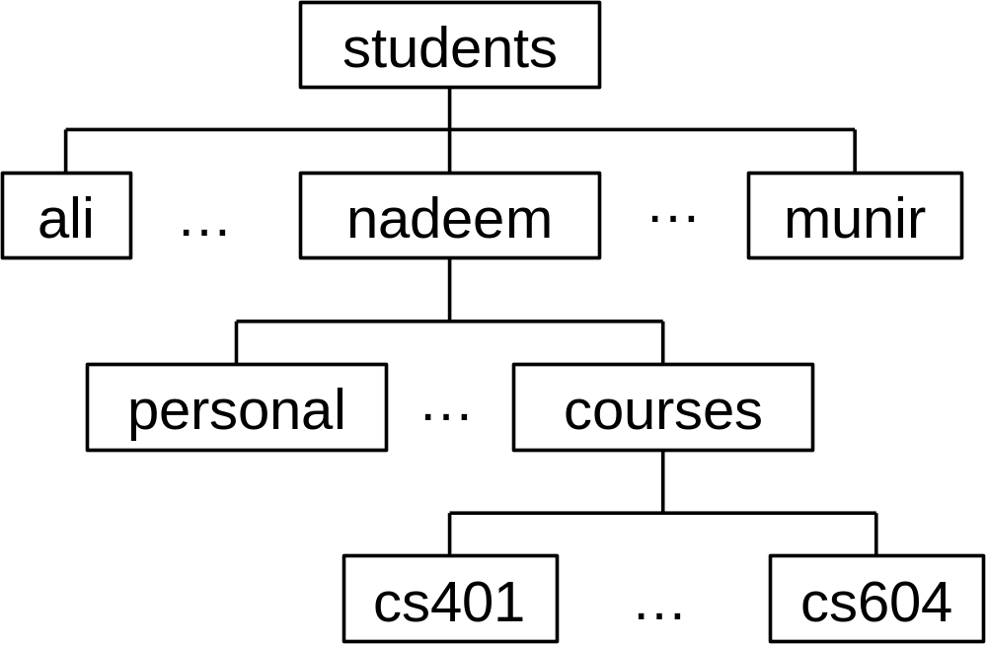
UNIX/Linux Directory Hierarchy

Slide 4
UNIX/Linux Directory Hierarchy
Root directory (/)
Home/login directory (~, $HOME, $home)
Current working directory (.)
Parent of the current working directory (..)

Slide 5
Browsing the File Hierarchy
ls Display contents of a directory
cd Change directory
pwd Print working directory
mkdir Create directory
rmdir Remove directory
cp Copy file
mv Move file
rm Remove file

Slide 6
Browsing the File Hierarchy
ls Display contents of a directory
cd Change directory
pwd Print working directory
mkdir Create directory
rmdir Remove directory
cp Copy file
mv Move file
rm Remove file

Slide 7
Browsing the File Hierarchy
mkdir temp
Create the ‘temp’ directory in your current directory
mkdir ~/courses/cs604/programs
Create the ‘programs’ directory in your ~/courses/cs604 directory
rmkdir ~/courses/cs604/programs Remove the ‘programs’ directory under your ~/courses/cs604 directory

Slide 8
Browsing the File Hierarchy
cp file1 file2
Copy ‘file1’ in your current directory to ‘file2’ in your current directory
cp ~/file1 ~/memos/file2
Copy ‘~/file1’ to ‘~/memos/file2’
mv file1 file2
Move ‘file1’ in your current directory to ‘file2’ in your current directory
mv ~/file1 ~/memos/file2
Move ‘~/file1’ to ‘~/memos/file2’

Slide 9
Browsing the File Hierarchy
rm file1
Remove ‘file1’ from your current directory
rm ~/courses/cs604/programs/test.c
Remove ‘test1’ in the ‘programs’ directory in your ~/courses/cs604 directory
rm *.o
Remove all .o (i.e., object) files from your current directory

Slide 10
Compiling and Running C Programs
$ gcc program.c
$ ../a.out
[ program output ]
$ gcc program.c –o assignment
$ assignment
[ program output ]
$ gcc program.c –o assignment -lm
$ assignment
[ program output ]
$

Slide 11
Useful Internet Resources
UNIX Tutorial for Beginners
  http://www.ee.surrey.ac.uk/Teaching/Unix/
  http://www.isu.edu/departments/comcom/unix/workshop/unixindex.html

Slide 12
Useful Internet Resources
emacs tutorial
  http://www.linuxjunkies.org/programming/IDE/emacs/
vi tutorial
  http://www.networkcomputing.com/unixworld/tutorial/009/009.html
  https://engineering.purdue.edu/ECN/Resources/KnowledgeBase/search_results?query=vi
pico tutorial
  http://www.itd.umich.edu/itdoc/r/r1168/

Slide 13
What is a process?
Process – a program in execution; process execution must progress in sequential fashion.
A process consists of:
  Code (text) section
  Data section
  Stack
  Heap
  Environment
  CPU state (program counter, etc.)
  Process control block (PCB)

Slide 14
CPU and I/O Bound Processes
Processes can be:
  I/O-bound process – spends more time doing I/O than computations, many short CPU bursts.
I/O Burst
CPU Burst
I/O Burst
CPU Burst
  CPU-bound process – spends more time doing computations; few very long CPU bursts.
CPU Burst
I/O
CPU Burst
I/O

Slide 15
Process States
As a process executes, it changes state
  new: The process is being created.
  ready: The process is waiting to be assigned to a processor.
  running: Instructions are being executed.
  waiting: The process is waiting for some event to occur.
  terminated: The process has finished execution.

Slide 16

Process States

Slide 17
Process Control Block (PCB)
Process information and attributes
  Process state
  Program counter
  CPU registers
  CPU scheduling information
  Memory-management information
  Accounting information
  I/O status information
  Per process file table
  Process ID (PID)
  Parent PID, etc.

Slide 18

Process Control Block (PCB)

Slide 19

CPU Switch From Process to Process

Slide 20
Process Scheduling Queues
Job queue – set of all processes in the system.
Ready queue – set of all processes residing in main memory, ready and waiting to execute.
Device queues – set of processes waiting for I/O devices.
Process migration between the various queues.

Slide 21

Queues in the OS

Slide 22

Queues in a Computer System

Slide 23
Schedulers
Long term scheduler
Short term scheduler
Medium term scheduler

Slide 24
Recap of Lecture
Review of previous lecture
Browsing UNIX/Linux directory structure
Useful UNIX/Linux commands
Process concept
Process scheduling concepts

